Slide 1
Clean Air V’s Pollution
Clean Air School’s Programme

Slide 2
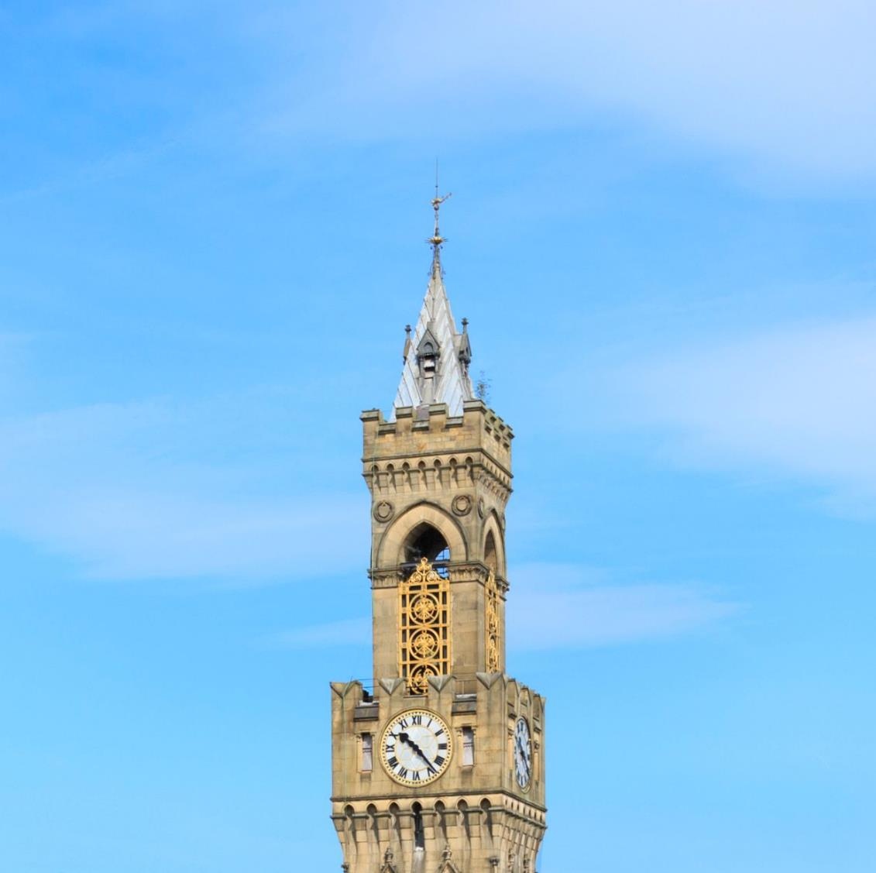
Bright, Clear Sky
Notes:
Visibility is high, and the sky appears blue without any haze.
Clouds, if present, look white and distinct.

Slide 3
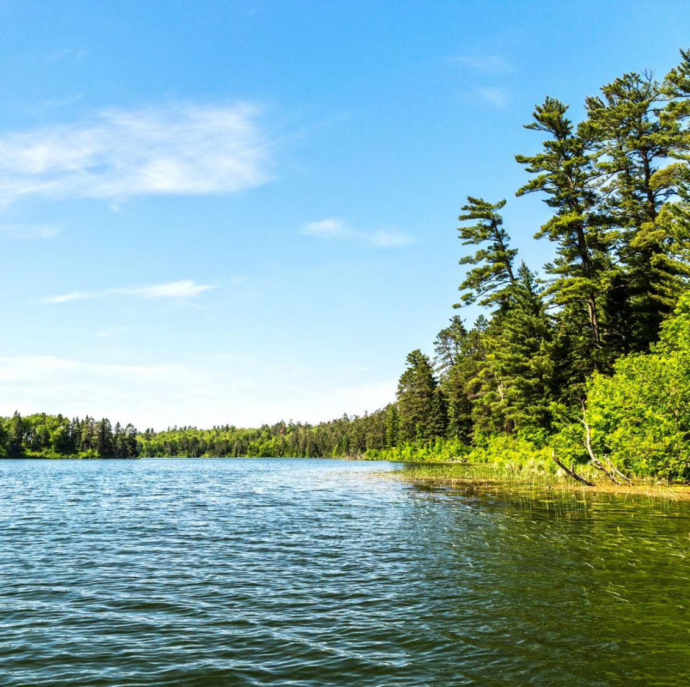
Natural Scenery
Notes:
Trees and vegetation appear vibrant and green.
Water bodies like rivers and lakes look clear.

Slide 4
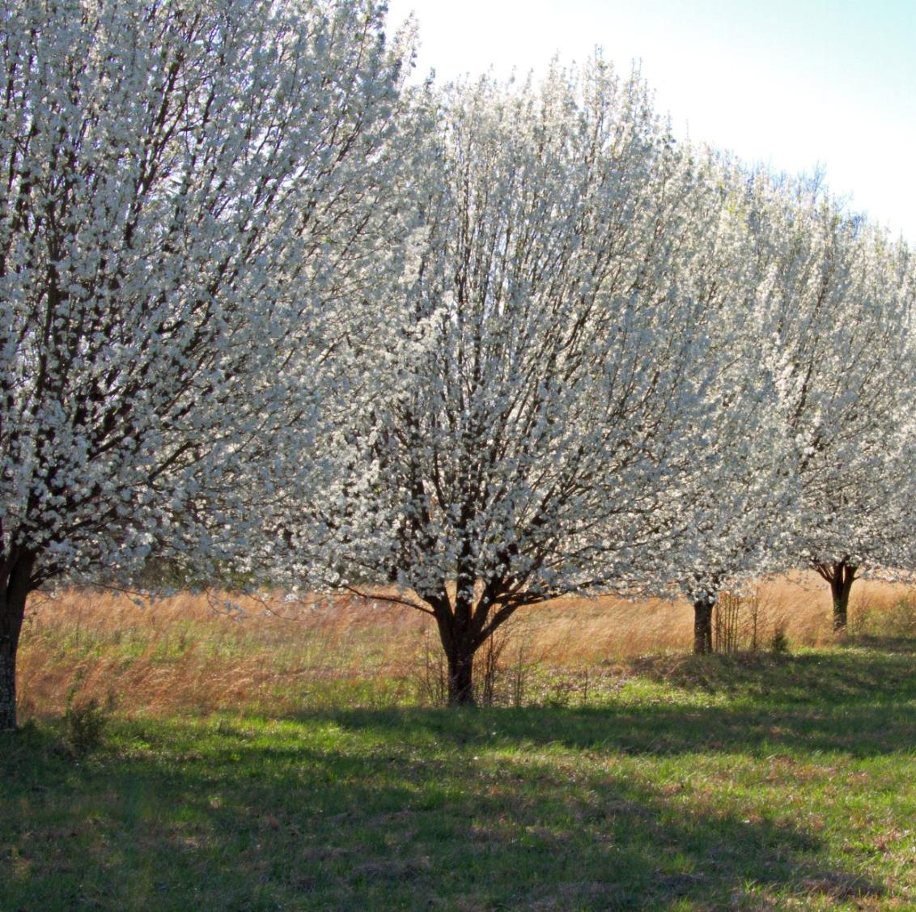
Natural Scenery
Notes:
Trees and vegetation appear vibrant and green.
Water bodies like rivers and lakes look clear.

Slide 5
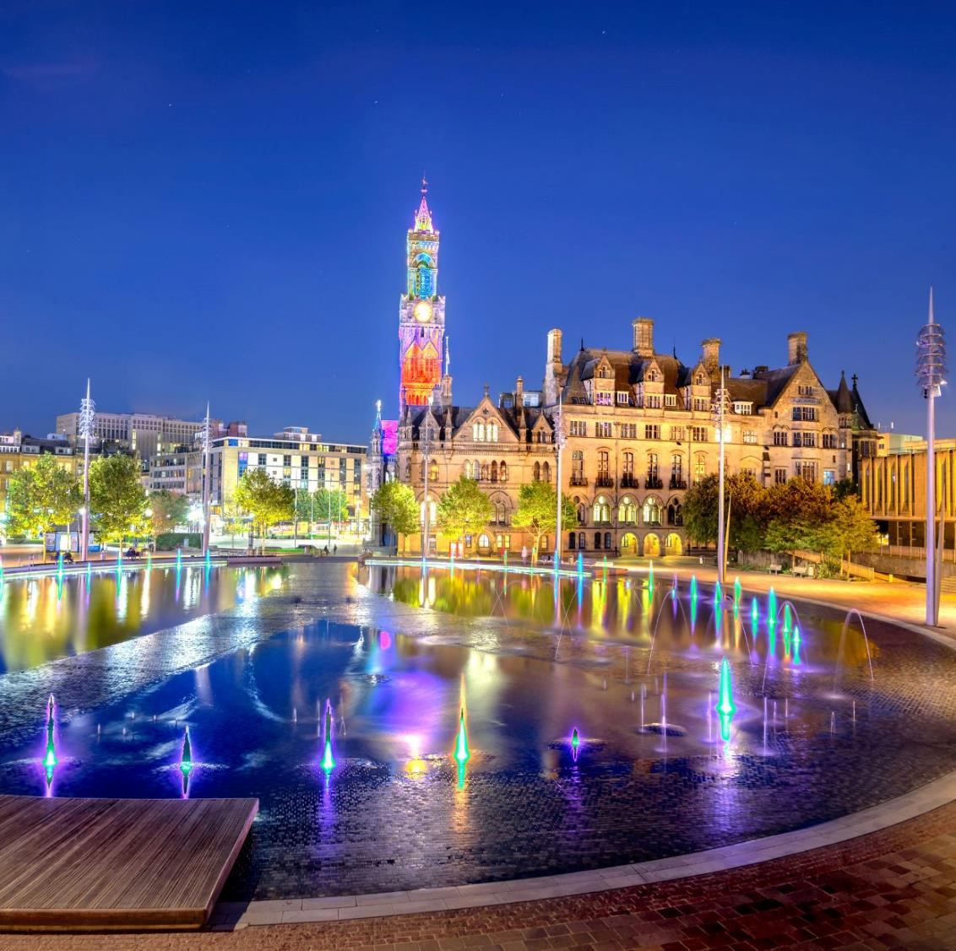
Urban Environment
Notes:
Buildings and structures are clearly visible from a distance.
The air feels fresh and breathable.

Slide 6
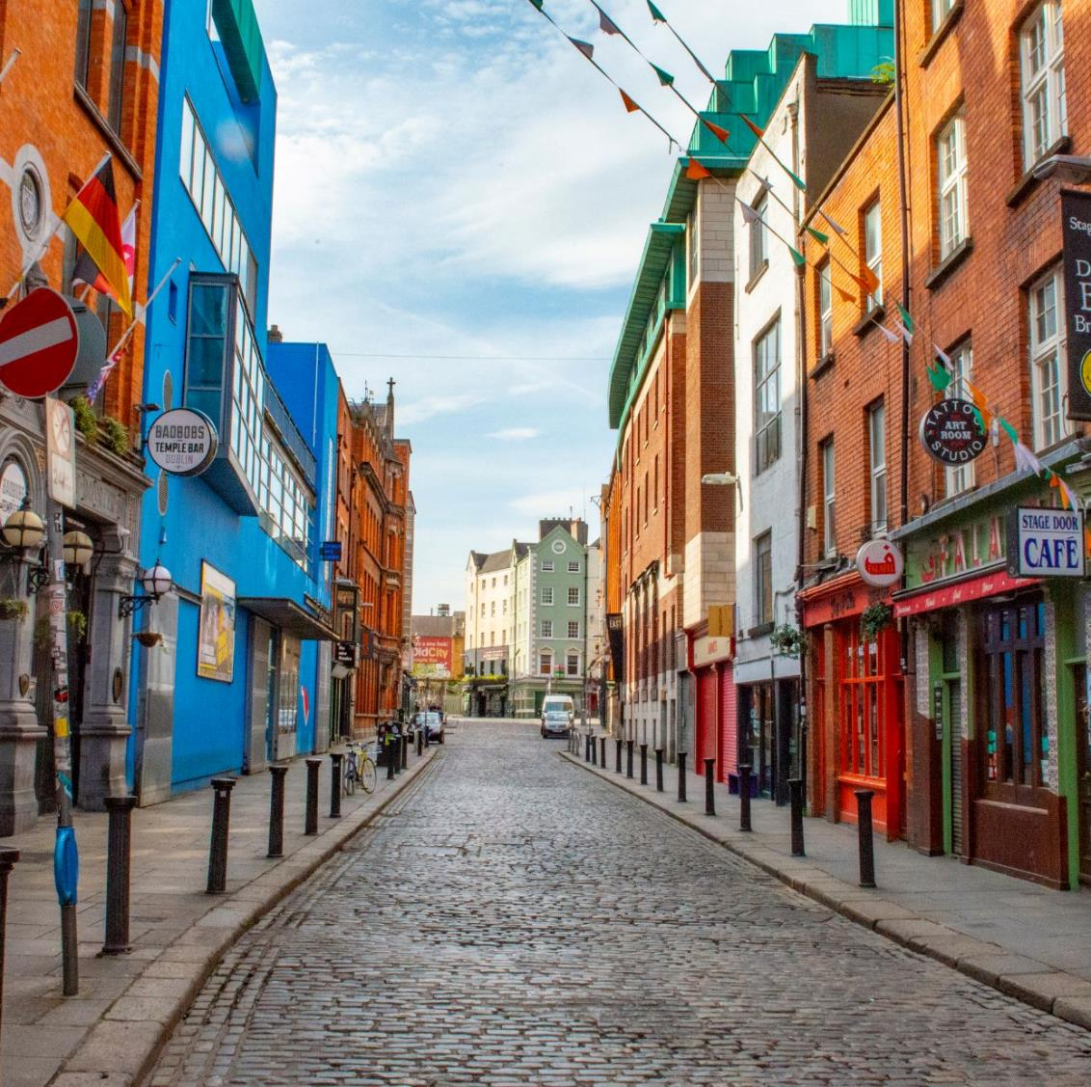
Urban Environment
Notes:
Buildings and structures are clearly visible from a distance.
The air feels fresh and breathable.

Slide 7
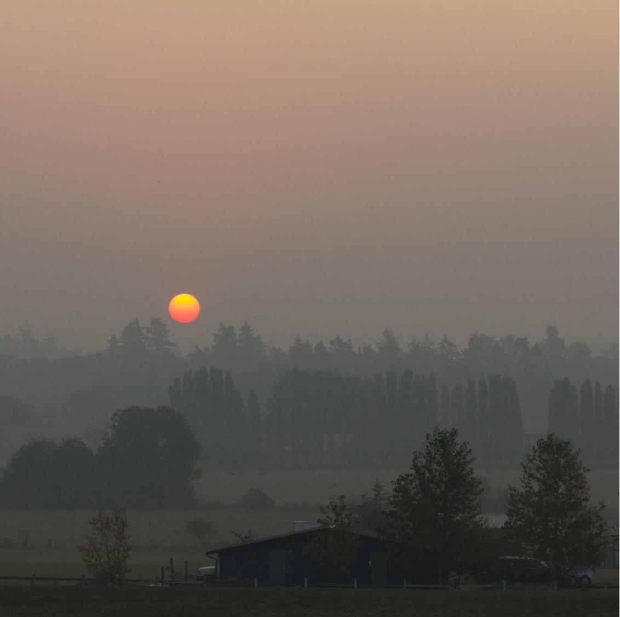
Hazy, Dull Sky
Notes:
Hazy, Dull Sky
Visibility is low, and the sky may appear grey or brown due to smog or particulate matter.
Clouds, if present, may look dull and blurred.

Slide 8
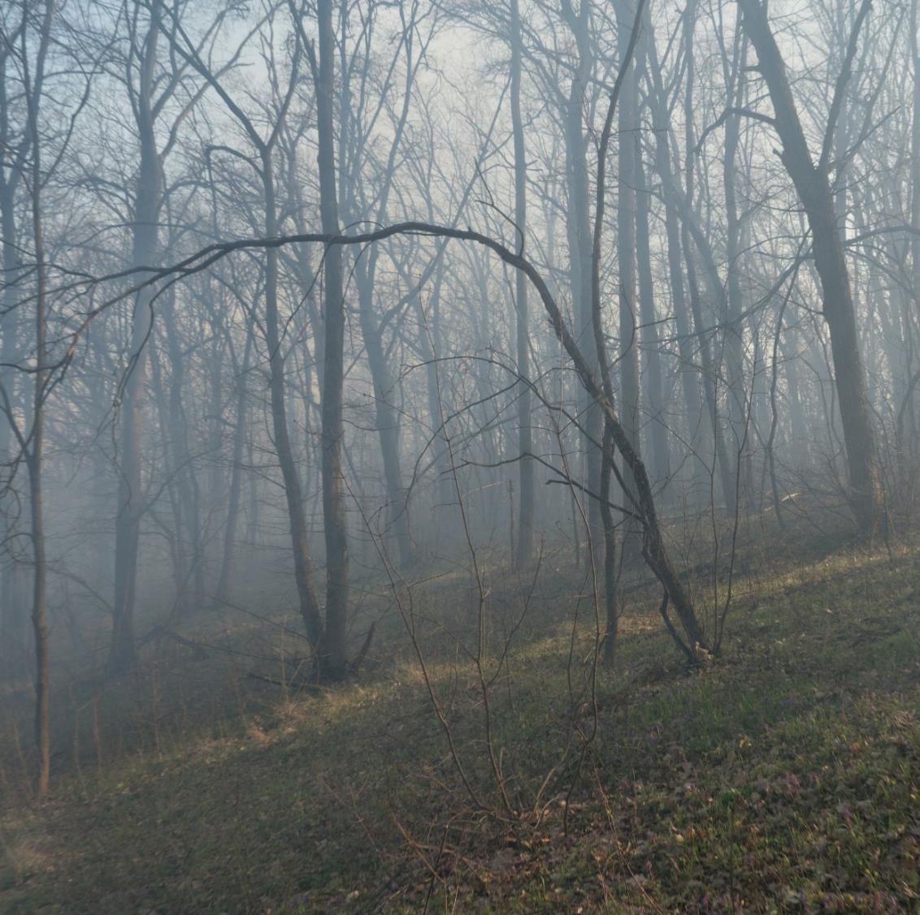
Natural Scenery
Notes:
Trees and vegetation may look dusty or discoloured.
Water bodies might appear murky or have a film on the surface.

Slide 9
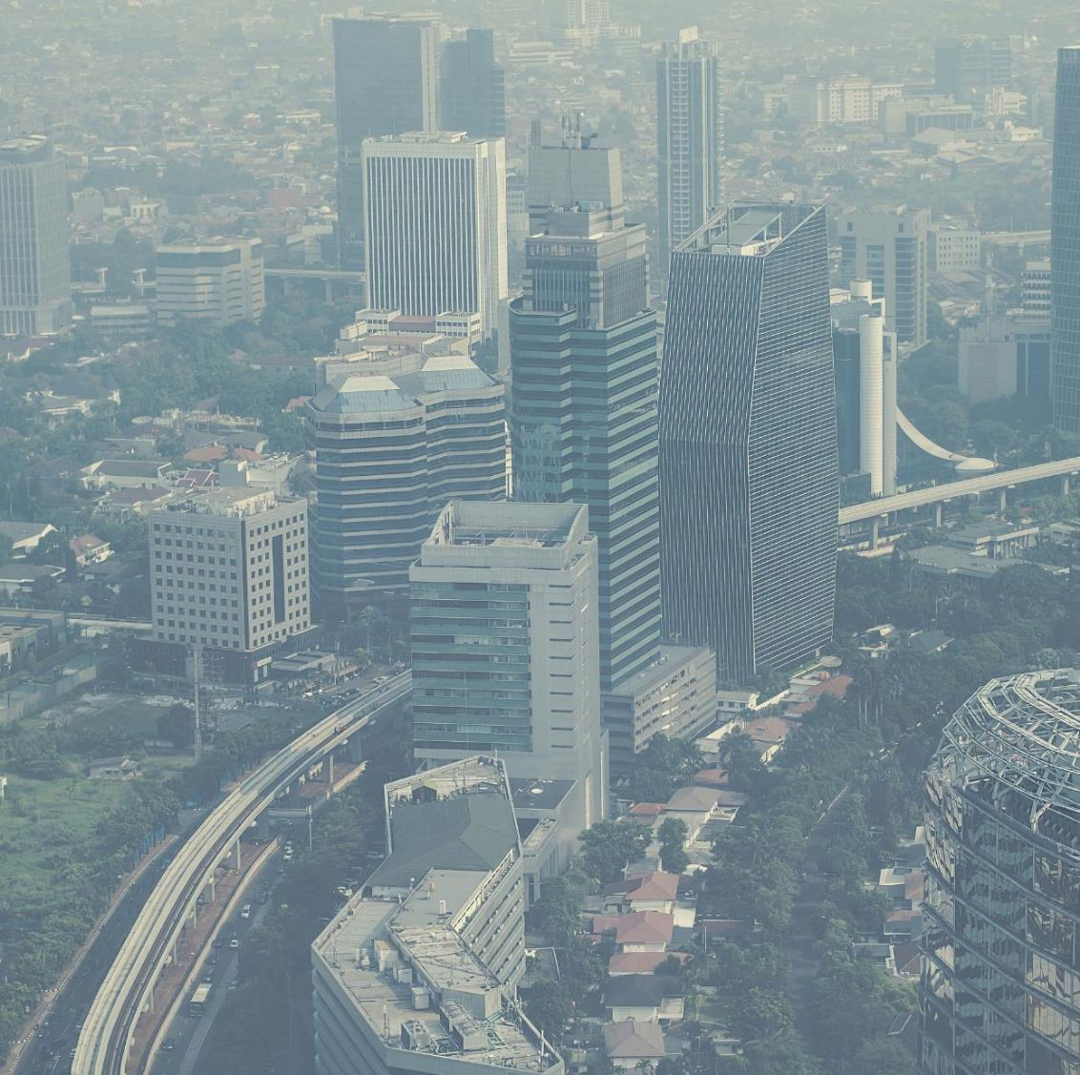
Urban Environment
Notes:
Buildings and structures appear obscured or blurred due to the haze.
The air may feel thick and have an unpleasant odour.

Slide 10

Air Pollution particles are so small you cannot always see them.

